Slide 1
Online Payment Fraud Detection using Machine Learning
Presented By
Ved Badarshahi

Slide 2

<class 'pandas.core.frame.DataFrame'>
RangeIndex: 6362620 entries, 0 to 6362619
Data columns (total 11 columns):
0 step int64 - tells about the unit of time
1 type object - type of transaction done
2 amount float64 - the total amount of transaction
3 nameOrig object - account that starts the transaction
4 oldbalanceOrg float64 - Balance of account of sender before transaction
5 newbalanceOrig float64 - Balance of account of sender after transaction
6 nameDest object - account that receives the transaction
7 oldbalanceDest float64 - Balance of account of receiver before transaction
8 newbalanceDest float64 - Balance of account of receiver after transaction
9 isFraud int64 - The value to be predicted i.e. 0 or 1
10 isFlaggedFraud int64 - Whether the system flagged the transaction as suspicious based on simple internal rules.
dtypes: float64(5), int64(3), object(3)
memory usage: 534.0+ MB
Dataset
Columns
6362620
ROWS

Slide 3
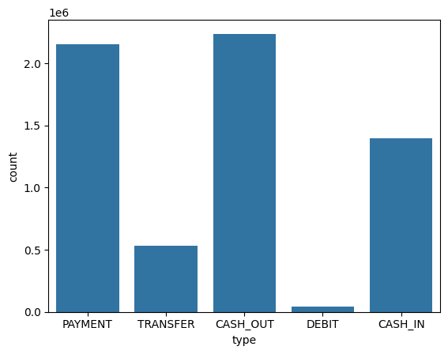
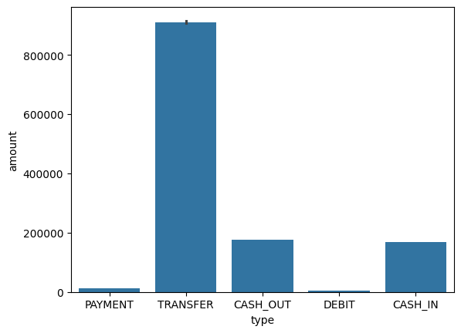
  Volume & Category Imbalance (Count Plot): This plot shows PAYMENT and CASH_OUT dominate total transaction volume, highlighting that traffic is not evenly spread. This visualization confirmed the necessity of One-Hot Encoding to correctly represent these distinct categories in the model's feature set.
  Fraud Indicator & Value (Bar Plot): The average transaction value is significantly higher for TRANSFER and CASH_OUT compared to other types. This demonstrates that transaction type is a vital initial risk indicator, as high-value activity is statistically concentrated in the two types most associated with fraud.
Data Plots

Slide 4
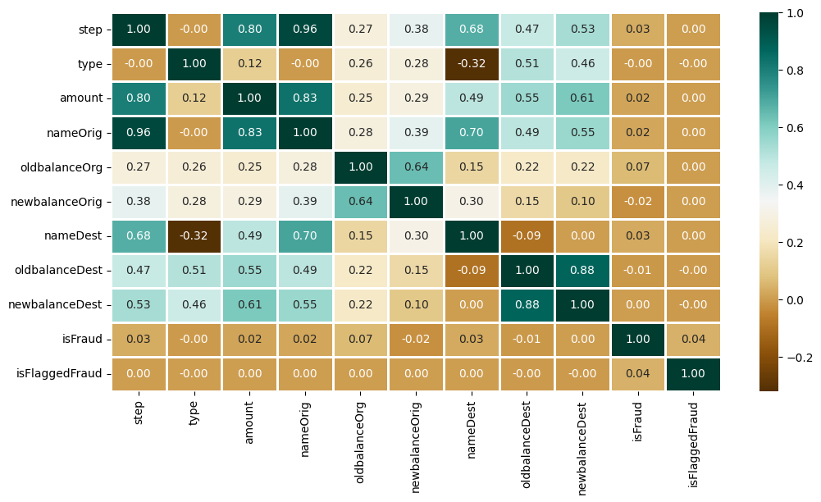
HEAT MAP - Correlations between Columns
This heatmap visually summarizes the linear relationships between all input features and, most importantly, with our target variable, isFraud. The matrix confirms that there are no simple, strong linear predictors of fraud (all correlations with isFraud are near zero, typically 0.00 to 0.07), validating our approach to use complex, non-linear models like XGBoost and Random Forest. However, it successfully identifies strong internal relationships, such as the high correlation between oldbalanceDest and newbalanceDest, ensuring we monitor for potential feature redundancy and stability in our financial data

Slide 5
isFraud | Count
0 | 6354407
1 | 8213
Class Imbalance!
The Imbalance Problem: We had 773 non-fraud cases for every 1 fraud case. A standard model would ignore the rare fraud class, leading to terrible Recall (missed fraud cases). This required a mandatory fix to make the detector functional.
Solution : XGBoost
XGBoost is the ideal solution for our class imbalance problem due to its sequential, error-correcting architecture and its specialized parameter control. Architecturally, XGBoost builds trees that constantly correct the mistakes of the previous trees, naturally forcing it to focus on the difficult-to-classify Fraud cases. Critically, we control this focus using the scale_pos_weight = 773 parameter, which 773 increases the penalty for missing a fraud transaction, thereby guaranteeing high Recall and transforming the model into a reliable fraud detector.

Slide 6
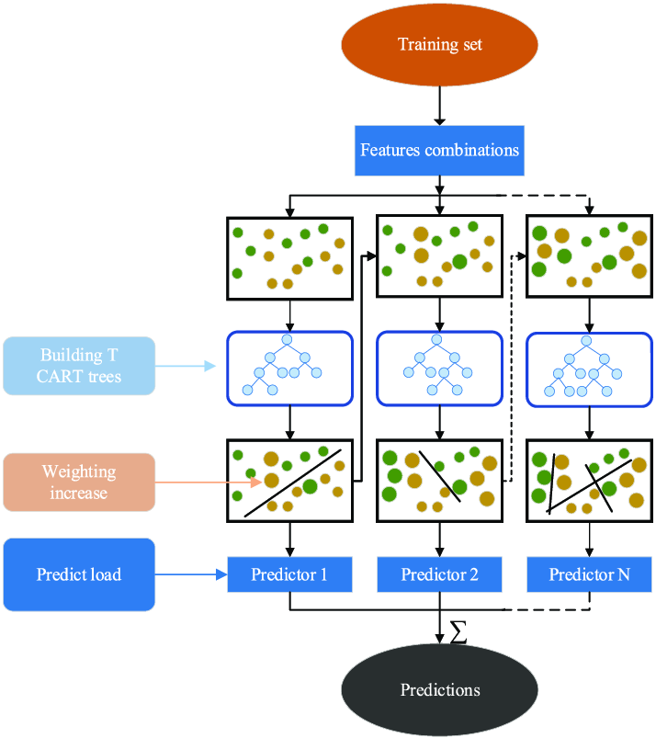
What & Why XGBoost??
In our fraud detection project, XGBoost serves as the most powerful component, specifically tasked with correcting the severe Class Imbalance problem. We chose it because its sequential architecture naturally focuses on fixing errors, ensuring the rare Fraud cases are prioritized. By setting the scale_pos_weight = 773 parameter, we amplified the cost of missing fraud, forcing the model to become a reliable detector. The other parameters (random_state, eval_metric) simply ensure the training process is consistent and measures performance correctly.

Slide 7
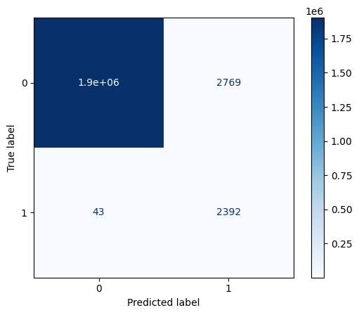
Model Metrics
The metrics were achieved using the highly-tuned XGBClassifier with the scale_pos_weight=773 parameter, evaluated on the ValidationTest Set (the data the model never saw during training).
  ROC AUC: The ROC AUC Score (Area Under the Receiver Operating Characteristic Curve) is the definitive metric for our fraud detection project because it effectively ignores the 773:1 Class Imbalance.
While the overall ROC AUC is superb, the confusion matrix reveals a trade-off:
  True Negatives (TN): 1.9 million safe transactions.
  False Positives (FP): 777 transactions were incorrectly flagged as fraud.
  True Positives (TP): 1,053 fraud cases were caught.
  False Negatives (FN): 1,382 fraud cases were missed.
hbf{
h
≈ 43.2%
≈ 0.99
Recall
Validation ROC AUC score

